Slide 1
RESET INTERNET BANKING TRANSACTION PASSWORD ONLINE
ALL YOU REQUIRE IS ??
ATM CARD LINKED TO YOUR ACCOUNT NUMBER ALONG WITH CARD EXPIRY DATE AND PIN
REGISTRED MOBILE NUMBER TO RECEIVE OTP

Slide 2
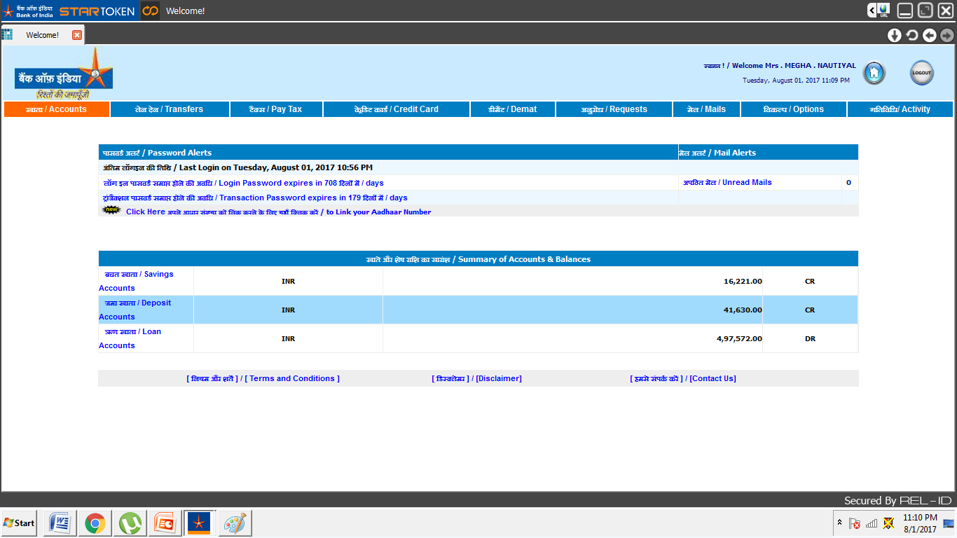
Click on Options

Slide 3
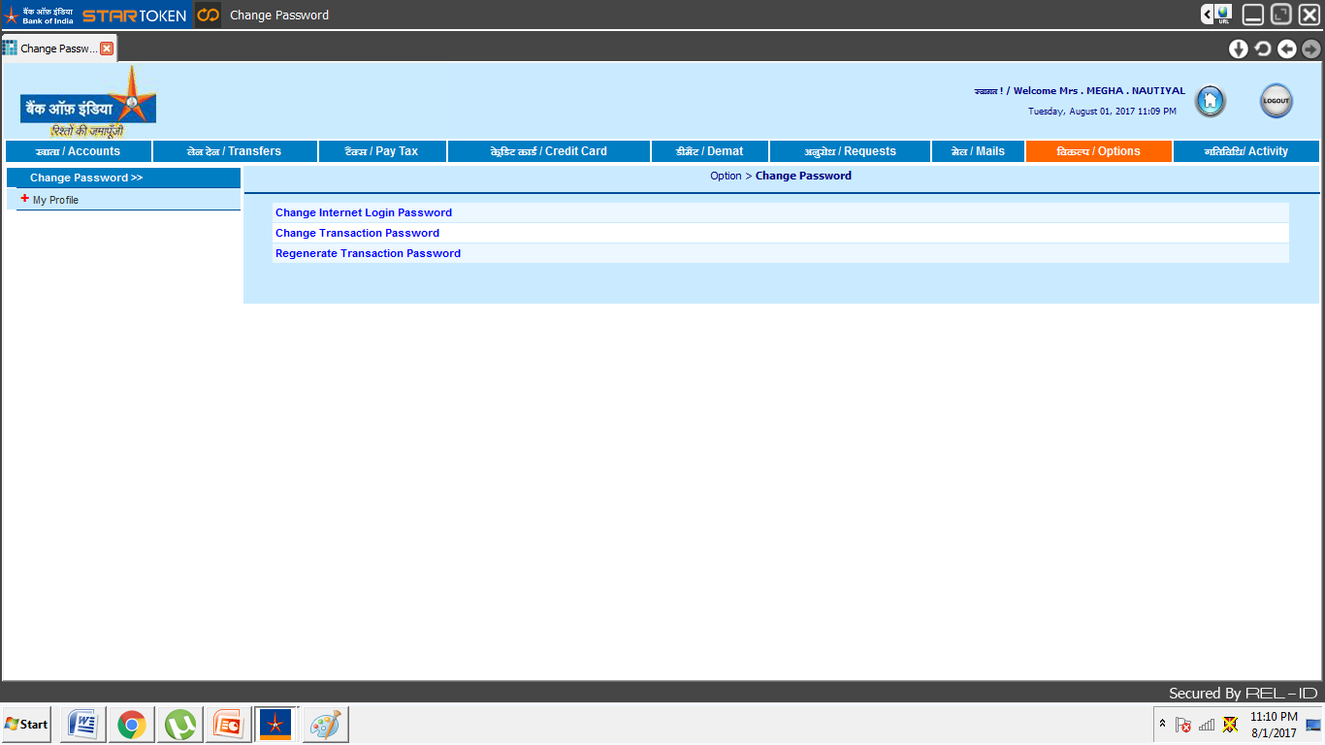
Click on Regenerate Transaction Password

Slide 4
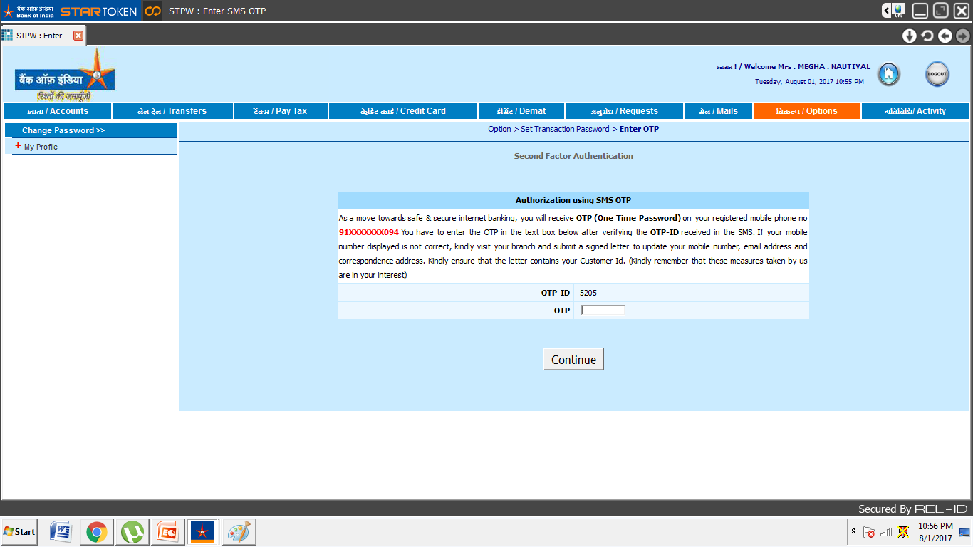
Enter OTP received on your registered mobile number and click on continue

Slide 5
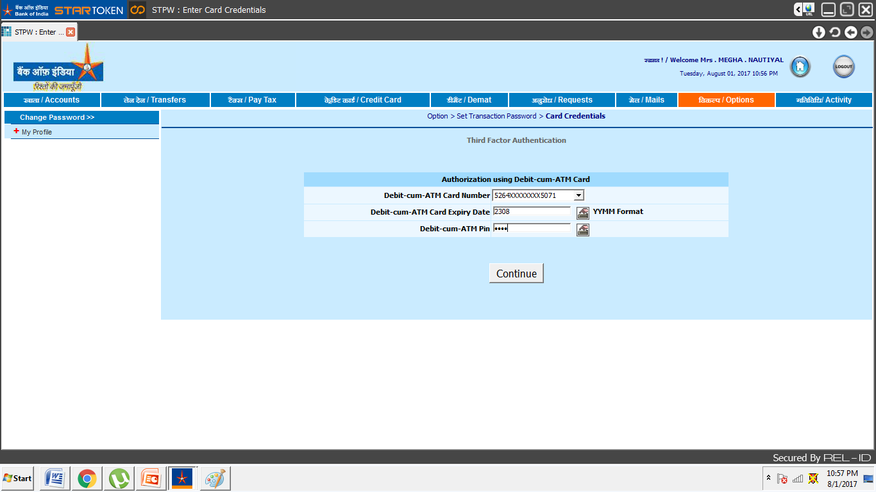
Select the debit card from drop down and enter the expiry date(yymm format) and PIN of ATM card
z

Slide 6
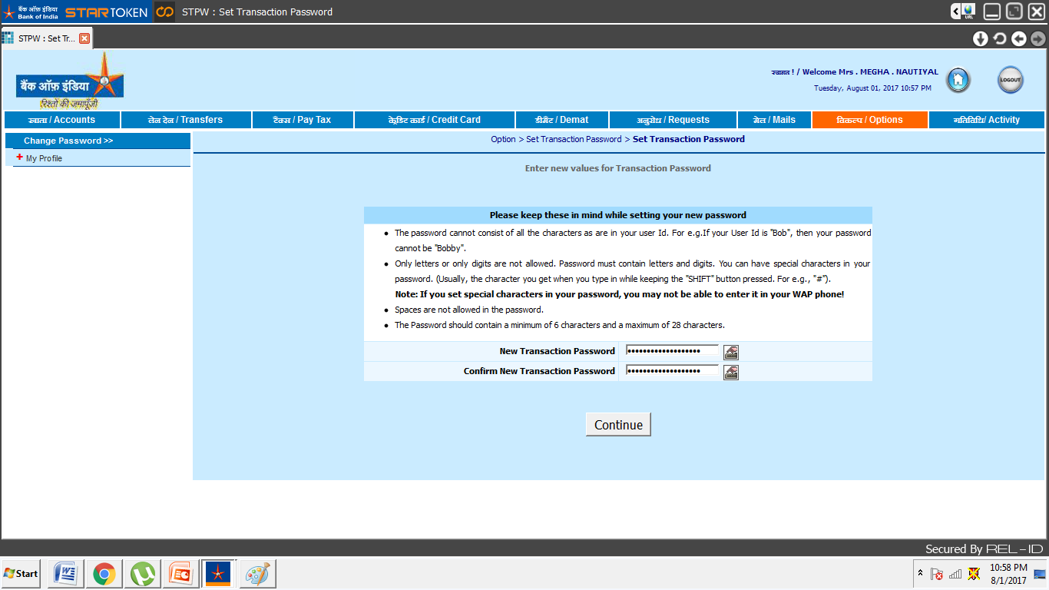
Enter and Re-enter new Internet Banking transaction password

Slide 7
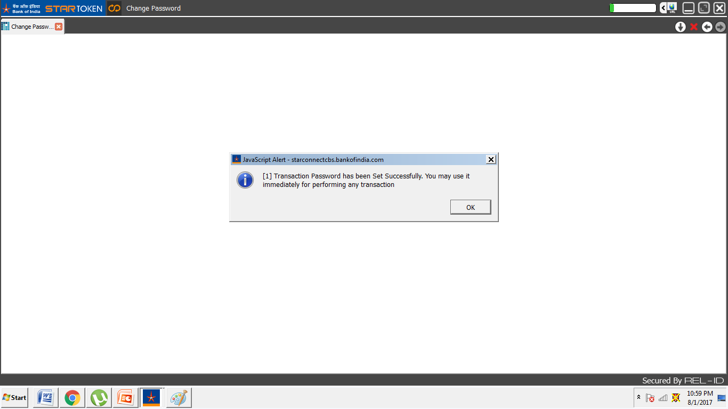
Transaction Password Set successfully.

Slide 8
SMS received for confirmation of successful setting of transaction password

